Slide 1

W209 Project -
Cryptocurrency Trading Dashboard
Team 1: Jeffrey Adams, Pow Chang, Sweta Bhattacharya, Matt White

Slide 2
Objective
Create an interactive trading dashboard for cryptocurrency traders
Present bitcoin and other cryptocurrency values in different graphical perspectives
Provide valuable information about cryptocurrency markets
Identify trends and illustrate events that affect behaviors
Allow the user to compare currencies, stocks and indices
Do the above with a minimalist design that provides the most information
Notes:
With the emergence of blockchain technology, bitcoin has become an important alternative financial asset for the monetary market
Bitcoin is a highly volatile commodity with a complex valuation model due to its cryptic algorithmic mining process

Slide 3
Audience
Over the years BTC has started to go from a fringe asset that only cryptographers traded and now it is an asset that the mainstream is starting trade
Many people don’t fully understand how or what BTC is
BTC is highly volatile and has many factors that influence its price
We want to help the person that is just learning about BTC and has questions about it:
Is this an asset I want to invest in?
Is it too volatile for me?
Should I invest in BTC, altcoins or traditional markets?
What causes the volatility in BTC? Can I see it coming?

Slide 4
Tasks
Compare different metrics with BTC and traditional markets such as price, daily return and ATR.
Compare different metrics with BTC and other altcoins such as price, daily return and ATR.
Discover outside influences that impact BTCs price and return
Global
Bitcoin history
Elon Musk
Google Trends

Slide 5
Proposed Insights
BTC’s returns track traditional markets but it is much more volatile
The overall returns of BTC have outpaced traditional markets
The built-in history of BTC has created cycles
Highly influential individuals and governments can impact BTC’s price

Slide 6
Data
Yahoo finance (API)
Traditional stocks and Indexes
Cryptocurrencies
Google trends (search)
Amount bitcoin is being searched for on google
BTC Events (curated)
Global influences
Bitcoin history
Elon Musk
Google Trends

Slide 7
Mockup

Slide 8
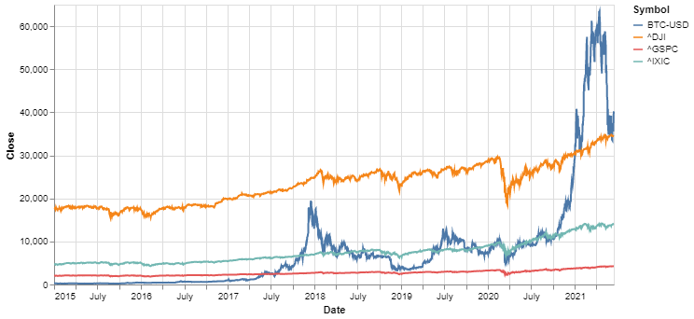
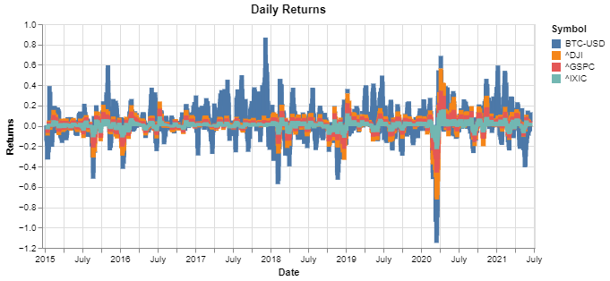
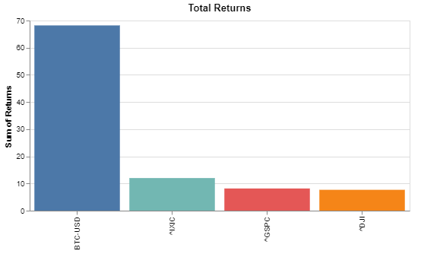
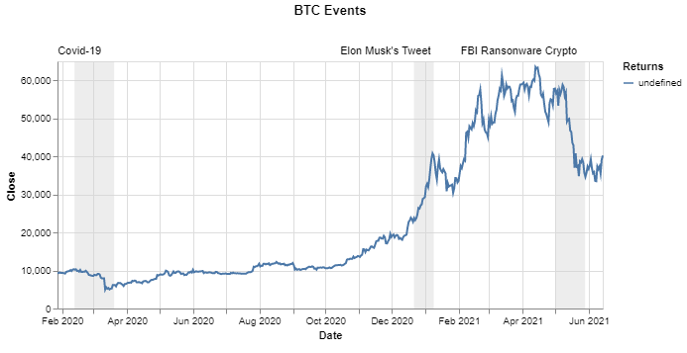
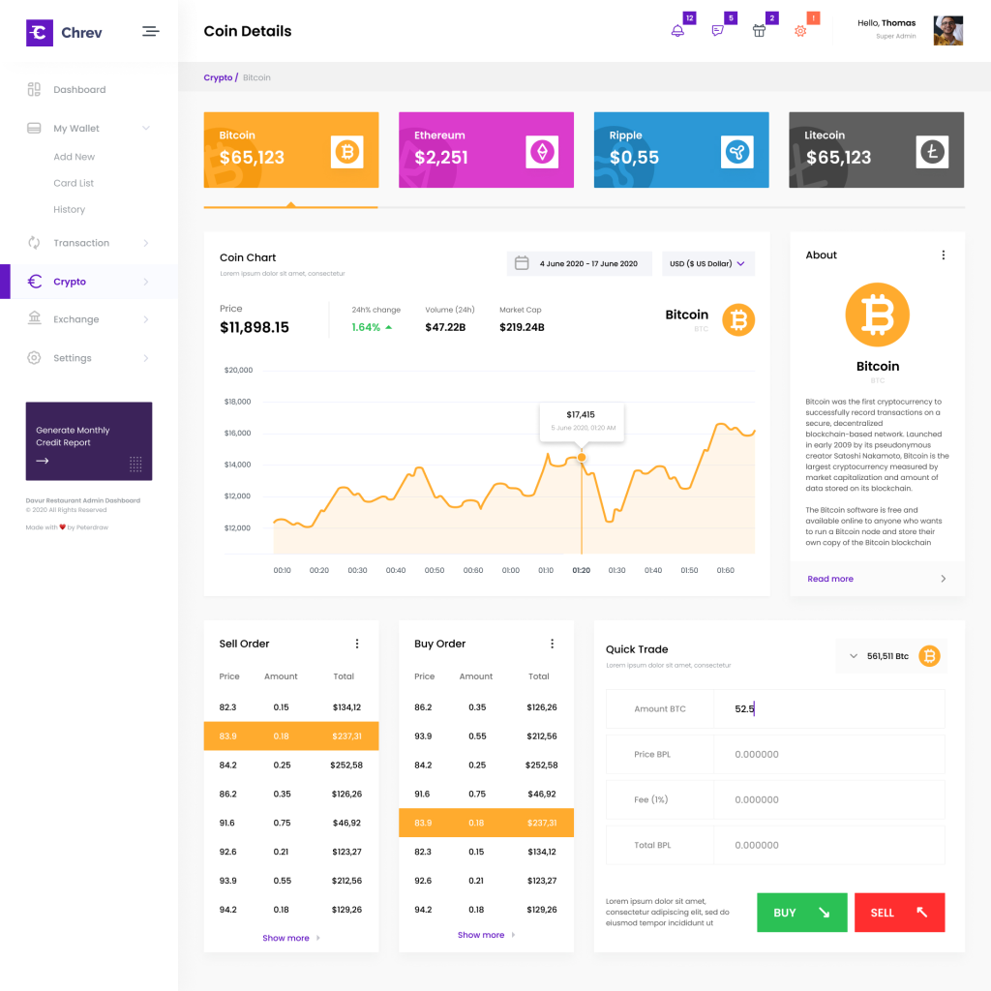
Cryptocurrency Trading Dashboard - Initial
Trader Dashboard
CryptoTrader
Comparison :
All
Index Funds
All Stocks
Tech Stocks
Alt Coins
Moving Ave
Events:
All
Global
Elon
Google Trends

Slide 9
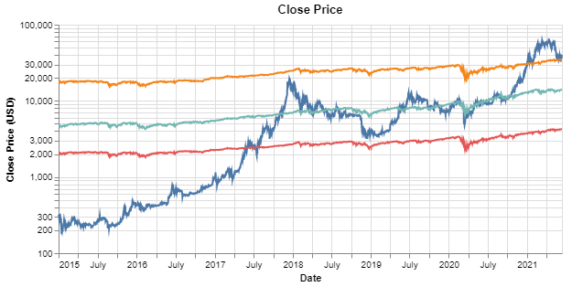
Cryptocurrency Trading Dashboard - Improvement
Trader Dashboard
CryptoTrader
Comparison :
All
Index Funds
All Stocks
Tech Stocks
Alt Coins
Moving Ave
Events:
All
Global
Elon
Google Trends

Slide 10
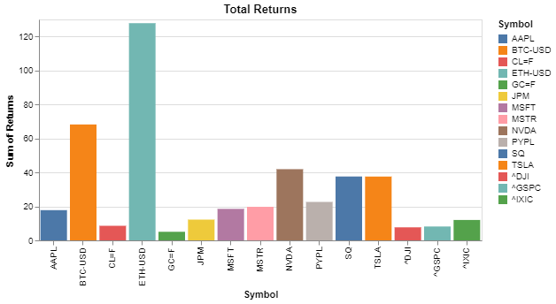
Value Over Time Panel 1 (initial)

Slide 11
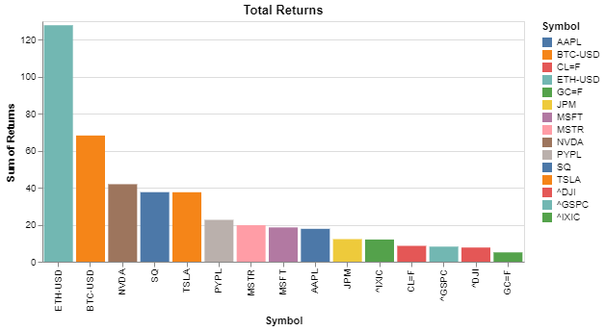
Value Over Time Panel 1 (initial)

Slide 12
Value Over Time Panel 2 (initial)

Slide 13
Value Over Time 2 (improvement)

Slide 14
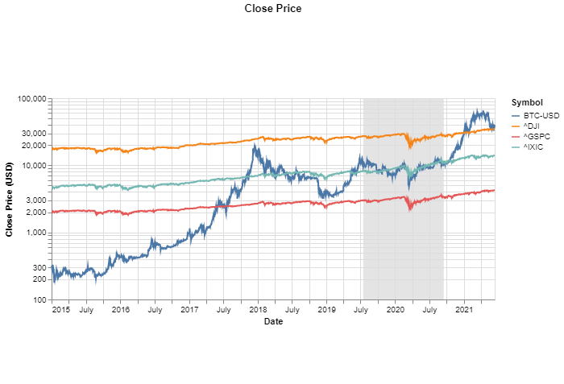
Value Over Time (improvement)
User can select a time period they want to focus on
All other charts we change to this selected time period

Slide 15
Daily Returns
BTC and index funds look very correlated, but BTC looks much more volatile
ADD Some kind of interaction

Slide 16
Total Returns
BTC might be more volatile, but it has much higher returns.
Select line charts based on bar plots
ADD Some kind of interaction

Slide 17
BTC Events
It looks like BTC has outside factors that influence its price and returns.
ADD Some kind of interaction

Slide 18
Visualization Pipeline
Data imported into Python NoteBook and created three CSV files after EDA
Visualizations created in Altair and exported to Vega-lite API
Visualizations loaded into Observable notebook (Dashboard) using VegaSync
Dashboard produced in Observable
Observable notebook embedded in HTML on UCB web server using flask

Slide 19
Test Plan and Usability Study
We will test our design initially with a set of documented functional tests
If all of our tests pass we will move on to our usability testing
We will solicit 5 users who can help provide feedback on our prototype
We will then incorporate any recommendations and then have our users retest

Slide 20
Old Slides

Slide 21
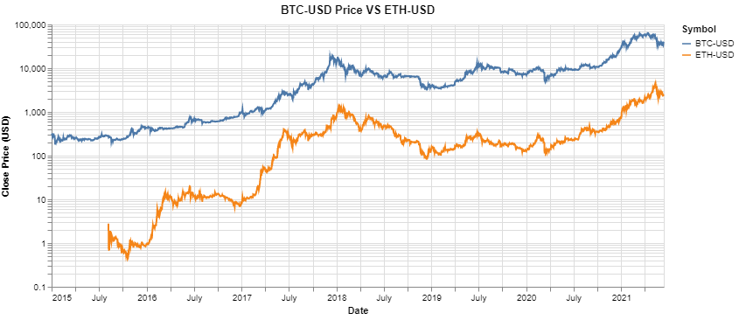
Initial Dashboard Mockup
User can determine what task they want to perform with the chart
Tasks:
Compare BTC to other markets
BTC non-market factors
The user will have different Chart Type options Depending on the task they select
Chart Type:
Close Price
Log Close Price
ATR
Daily Returns
Total Returns
Comparison with BTC:
All
Index Funds
All Stocks
Tech Stocks
Alt Coins
Moving Ave
The user can select what they would like to compare BTC to

Slide 22
There seems to be a correlation of BTC to Altcoins. Is it clearer when I look at returns?
Tasks:
Compare BTC to other markets
BTC non-market factors
Chart Type:
Close Price
Log Close Price
ATR
Daily Returns
Total Returns
User selects Daily returns
Comparison with BTC:
All
Index Funds
All Stocks
Tech Stocks
Alt Coins
Moving Ave

Slide 23
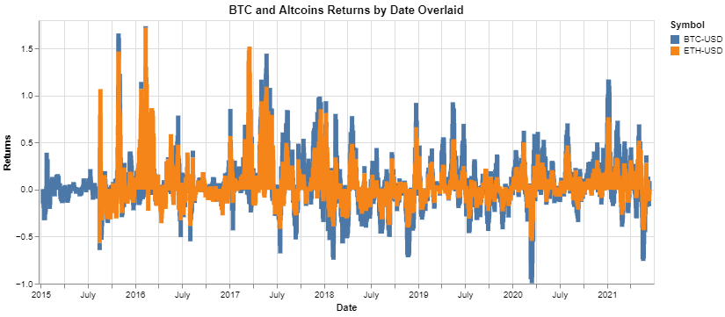
Based on this they do look very correlated, and very volatile. Is this as volatile as traditional markets?
Tasks:
Compare BTC to other markets
BTC non-market factors
Chart Type:
Close Price
Log Close Price
ATR
Daily Returns
Total Returns
Comparison with BTC:
All
Index Funds
All Stocks
Tech Stocks
Alt Coins
User selects Index Funds

Slide 24
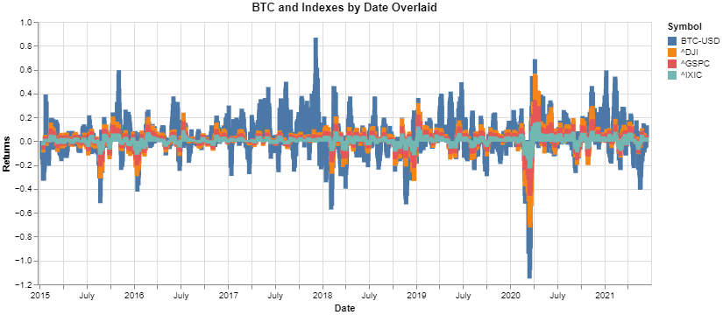
It is much more volatile than index funds. But does it have higher returns in the selected time frame?
Tasks:
Compare BTC to other markets
BTC non-market factors
Chart Type:
Close Price
Log Close Price
ATR
Daily Returns
Total Returns
User selects Total Returns
Comparison with BTC:
All
Index Funds
All Stocks
Tech Stocks
Alt Coins

Slide 25
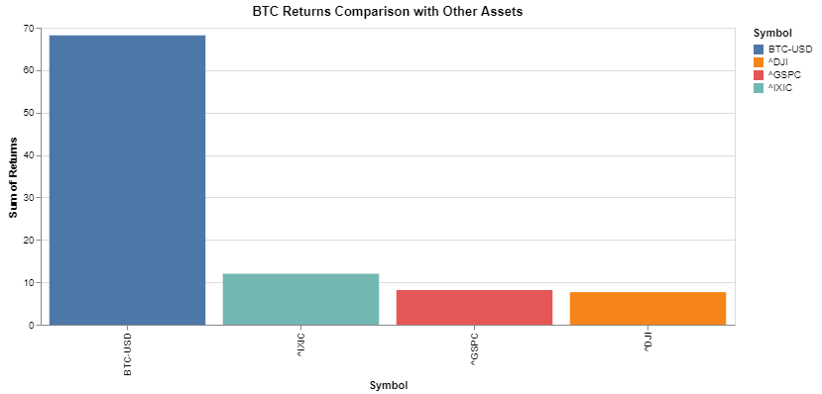
It might be more volatile, but it has much higher returns. What about with all assets in this dataset?
Tasks:
Compare BTC to other markets
BTC non-market factors
Chart Type:
Close Price
Log Close Price
ATR
Daily Returns
Total Returns
Comparison with BTC:
All
Index Funds
All Stocks
Tech Stocks
Alt Coins
User selects All Data

Slide 26
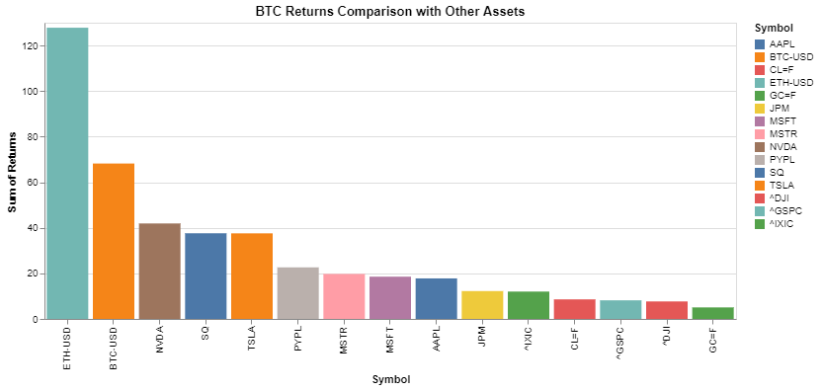
Looks like during this time frame crypto is outperforming other markets. Are there outside factors causing volatility?
Tasks:
User selects BTC non-market factors
Compare BTC to other markets
BTC non-market factors
Chart Type:
Close Price
Log Close Price
ATR
Daily Returns
Total Returns
Comparison with BTC:
All
Index Funds
All Stocks
Tech Stocks
Alt Coins

Slide 27
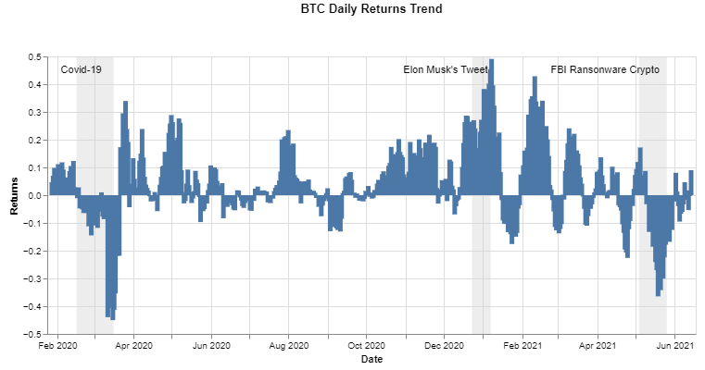
It looks like BTC has outside factors that influence its price and returns. Do these events influence ATR?
Tasks:
Compare BTC to other markets
BTC non-market factors
Chart Type:
Close Price
Log Close Price
ATR
Daily Returns
Month and DOW
User selects ATR
Events:
All
BTC History
Global
Elon
Google Trends
Chart options adjust with different tasks

Slide 28
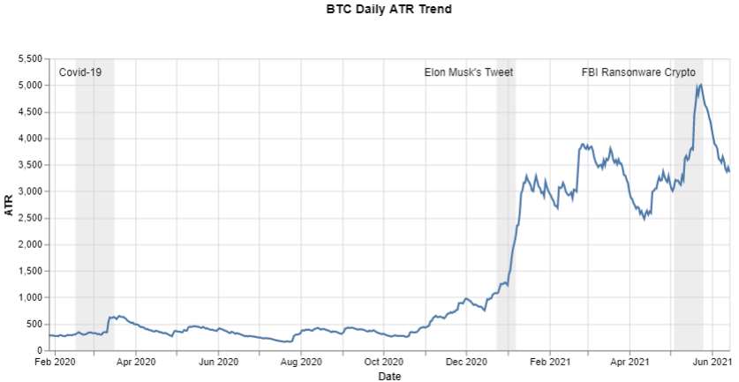
Does the month or the Day of the Week impact price?
Tasks:
Compare BTC to other markets
BTC non-market factors
Chart Type:
Close Price
Log Close Price
ATR
Daily Returns
Month and DOW
User selects Month and DOW
Events:
All
BTC History
Global
Elon
Google Trends

Slide 29
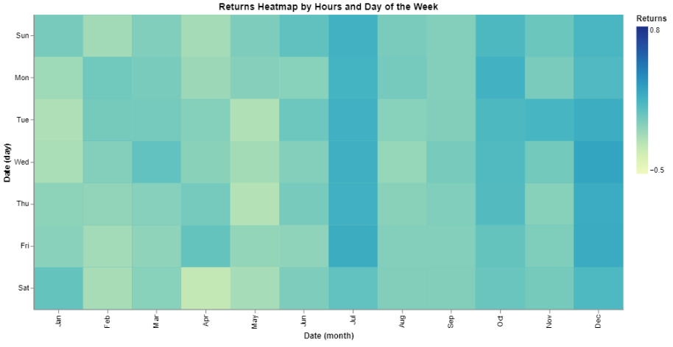
Does the month or the Day of the Week impact price?
Tasks:
Compare BTC to other markets
BTC non-market factors
Chart Type:
Close Price
Log Close Price
ATR
Daily Returns
Month and DOW
Chart options adjust with different tasks

Slide 30
Hypothesis
Hypothesis 1: Cryptocurrency market trends mirror traditional markets.
Hypothesis 2: Alt coins are highly correlated with and follow Bitcoin price
Hypothesis 3: Cryptocurrency market is highly influenced by non-market factors that don't affect traditional markets

Slide 31
Visualization Pipeline
Dashboard produced in Observable
Observable notebook embedded in HTML on UCB web server using flask
Data processed by Python and loaded into 3 CSV files
Visualizations created in Altair and exported to Vega-lite API
Visualizations loaded into Observable notebook (Dashboard) using VegaSync
Leverage “Full Screen” in order to create a Dashboard that covers entire screen

